Slide 1
DBMS of Facebook
Case study - I

Slide 2
DBMS of Facebook
There are quite a number of databases that Facebook uses in order to keep a record of the various information that is being shared by different people all over the world. Among them, few of the databases are:
MYSQL
HBase
Cassandra
Haystack
Memcached

Slide 3
Initial architecture
i.profile is not simply a list of attributes such as name, email, interests and so on.
Ii it is in fact a rich social graph that stores all friend/family relationships, groups, check-ins, likes, shares and more
Directed or undirected???

Slide 4
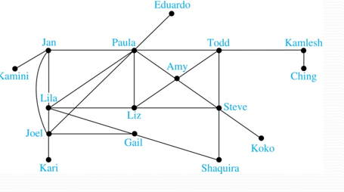
Graph example of FB

Slide 5
Initial architecture
This social graph was initially built as a PHP application powered by MySQL as the persistent database and memcache as a “lookaside” cache.
In the lookaside caching pattern, the application first requests data from the cache instead of the database. If the data is not cached, the application gets the data from the backing database and puts it into the cache for subsequent reads. Note that the PHP application was accessing MySQL and memcache directly without any intermediate data abstraction layer.

Slide 6
Memcache and Lookaside cache
Lookaside: A memory cache that shares the system bus with main memory and other subsystems.
Memcache: It is a distributed memory object caching system. Memcached is an in-memory key-value store for small chunks of arbitrary data

Slide 7
Problems with this design
i) Loss of Developer Agility: As there were two databases, a large SQL database for storing persistent data and a memcache for storing key value pair, so it was an issue.
Ii ) Application-Level Database Sharding : Sharding is a method of splitting and storing a single logical dataset in multiple databases
Iii ) Handling multiple datacenters in different locations
iv) Loss of data consistency between two DBMS.

Slide 8
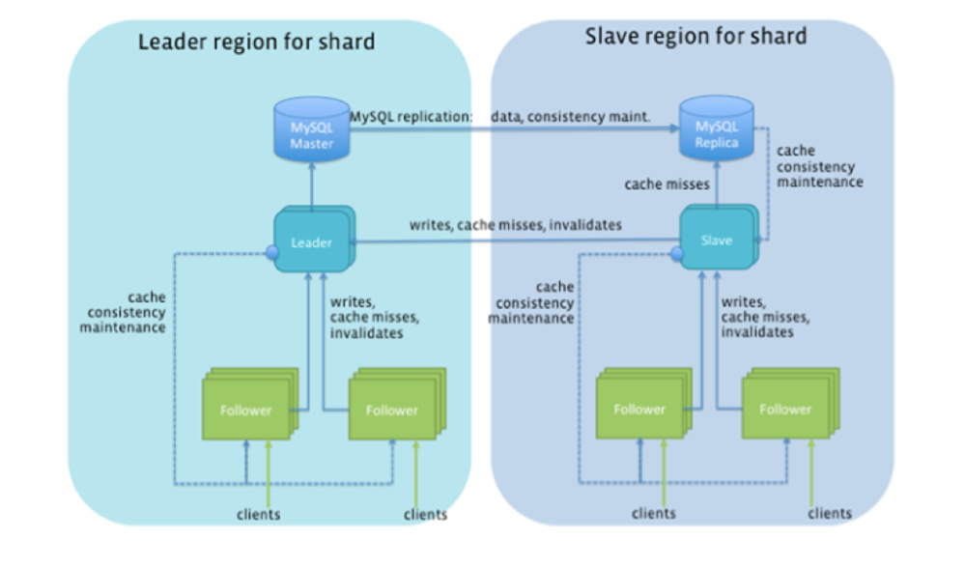
Solution : TAO a NO SQL

Slide 9
Resources
https://blog.yugabyte.com/facebooks-user-db-is-it-sql-or-nosql/
https://web.facebook.com/notes/facebook-engineering/tao-the-power-of-the-graph/10151525983993920/?_rdc=1&_rdr
https://www.gangboard.com/blog/what-database-does-facebook-use
https://www.usenix.org/conference/atc13/technical-sessions/presentation/bronson
https://www.digitalocean.com/community/tutorials/understanding-database-sharding

